Slide 1
Yardley Estates Lake Erosion Committee Lauren Eldaher, Brandon Kravitz, Jody Lukens, Dave Marty

Slide 2
background

Slide 3
Erosion problem reported
Yardley HOA Board:
Received letter from homeowner on the lake, asking HOA to address significant erosion of their property
Board consulted lawyer who confirmed lake erosion is HOA responsibility
Formed committee of homeowners to research erosion repair options, solicit bids, and present findings

Slide 4
research

Slide 5
Stormwater management overview
Water management systems required in residential developments to collect street/yard drainage
Interconnected flood-control system prevents flooding, erosion, and damage
While canals in Coral Springs are maintained by the Coral Springs Improvement District, community retention/ detention ponds generally managed by HOAs

Slide 6
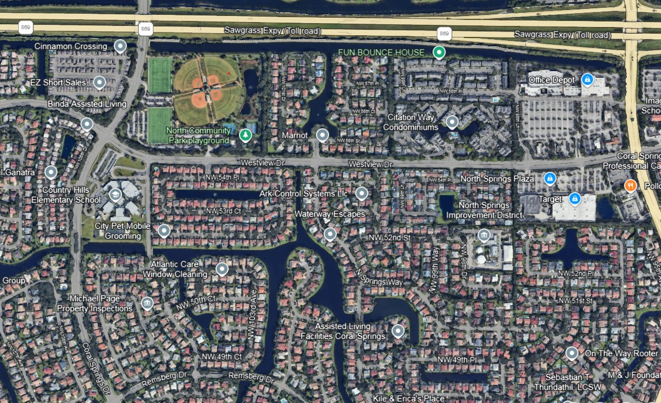
Interconnected Waterways

Slide 7
Stormwater management in communities
Detention ponds capture stormwater runoff and store temporarily until it can be safely released
Ponds need to be maintained to retain proper slope and mitigate erosion
Significant erosion can threaten the structure of nearby homes, potentially leading to expensive litigation by homeowners who experience damage to their property

Slide 8
City of Coral Springs Engineering standards
Proper shoreline grade for lake side slopes is not steeper than 1:4 ratio
Sod/yard should be minimum setback of 21’ to edge of water for one-story homes
Sod/yard should be minimum setback of 25’ to edge of water for two-story homes

Slide 9
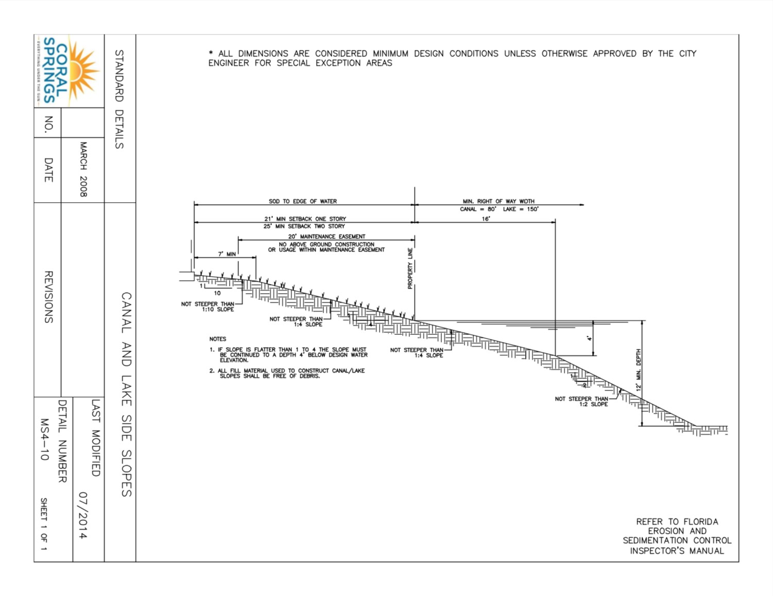

Slide 10
Yardley Detention Pond
Erosion has progressed and will require repair—too late for maintenance to successfully address the issue
It’s expensive to repair
Identification of two significant issues regarding compliance with City of Coral Springs engineering requirements:
1) Original shoreline eroded
2) Slope too steep

Slide 11
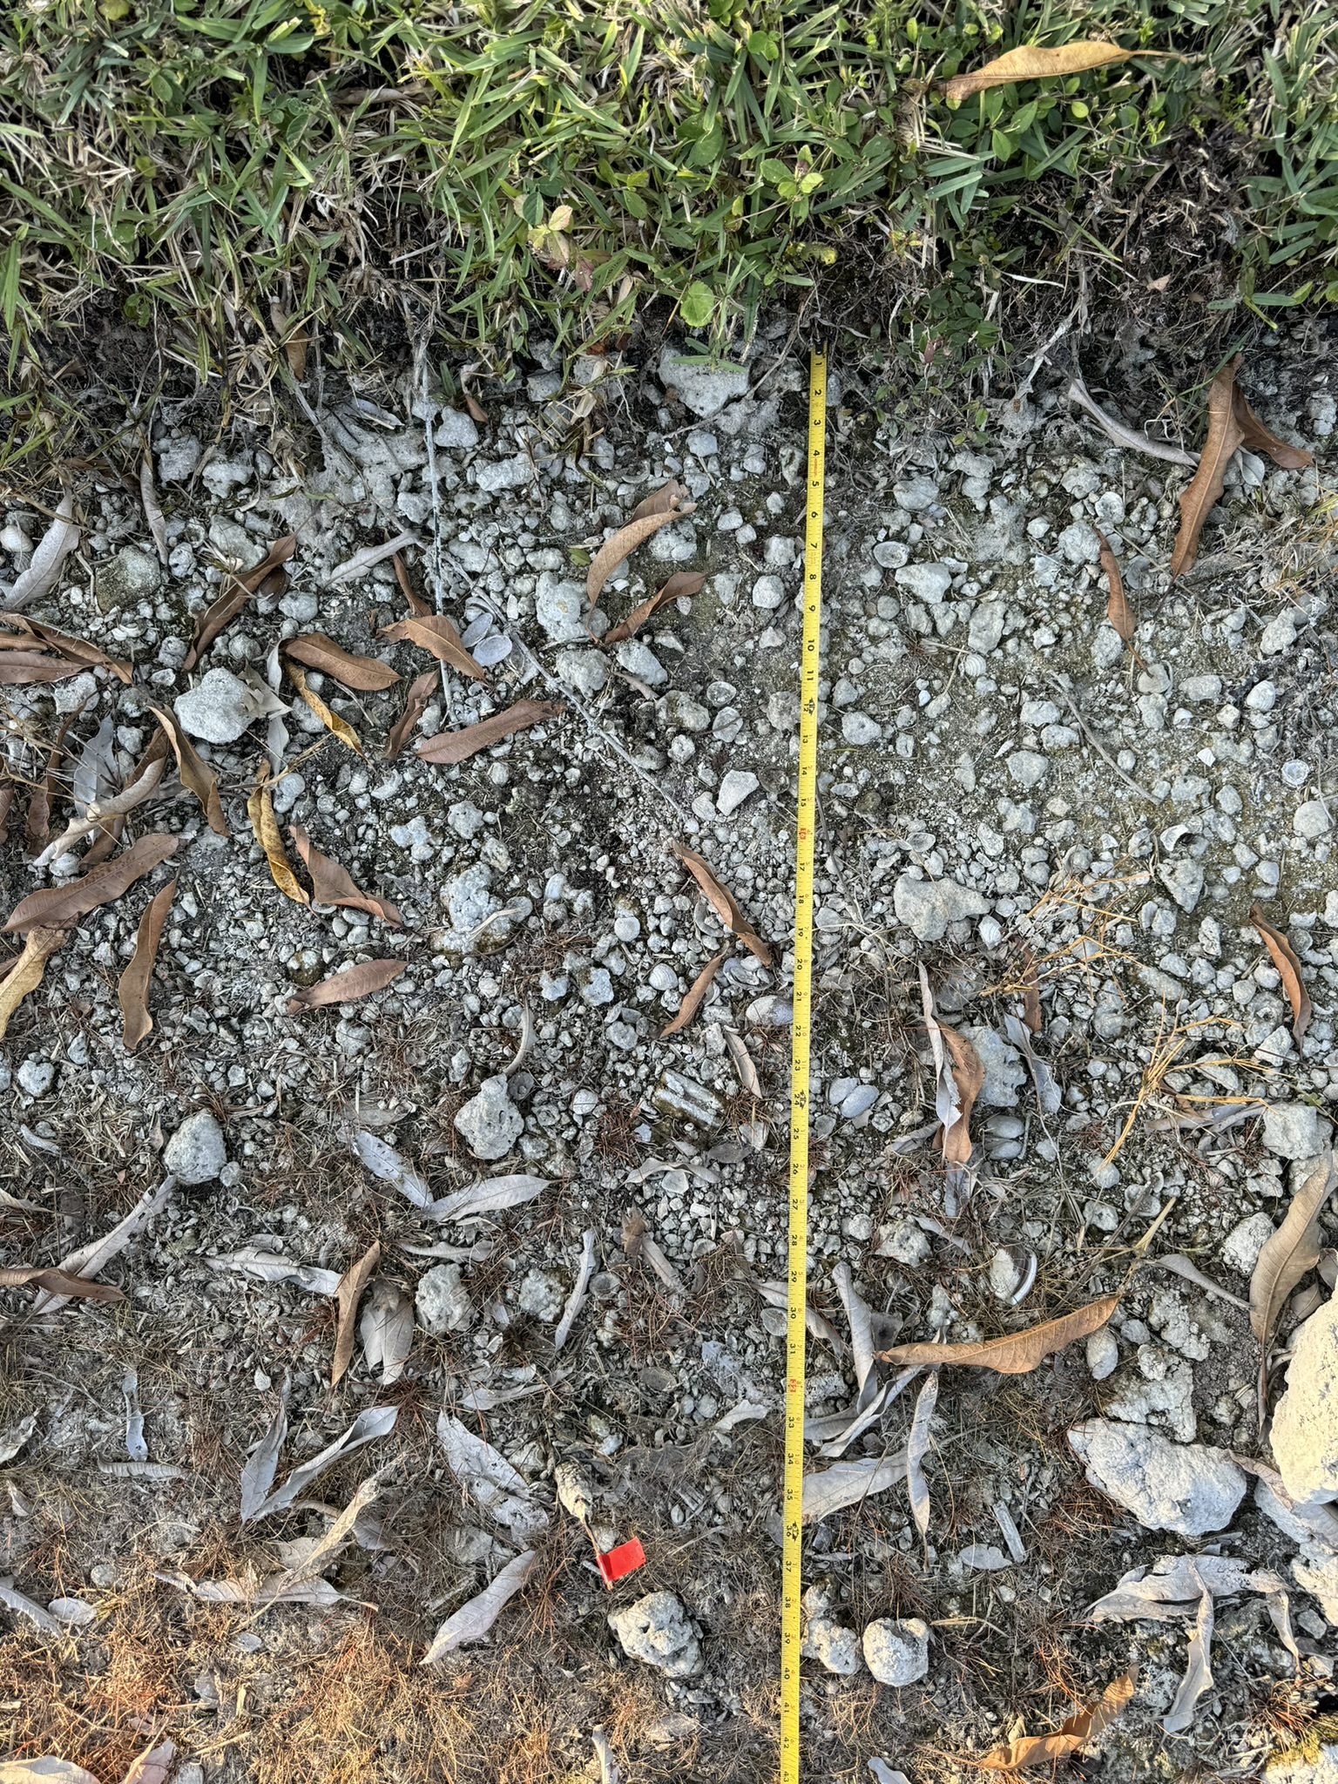
Yardley Shoreline Snapshot
Current shoreline

Slide 12
Yardley Shoreline Snapshot
Current shoreline
Property line marker from survey

Slide 13
Yardley Shoreline Snapshot
Current shoreline
Property line marker from survey

Slide 14
Yardley Shoreline Erosion
Shoreline has
receded/eroded
approx. 3-4 ft
Notes:
Shoreline has eroded over time by approximately 3-4 feet on average.

Slide 15
Yardley Shoreline Slope
Required 1:4 slope is now gone, replaced by 1ft + vertical drop
Notes:
A gradual slope helps dissipate wave action along the shoreline, which can lead to further erosion. Side slopes of 1:4 are recommended if riding mower is to be used, per “Best Management Practices for South Florida Urban Stormwater Management Systems” by the South Florida Water Management District, April 2002; www.sfwmd.gov

Slide 16
Shoreline restoration steps
Use of dredged sediment or imported fill to rebuild shore
Fill held in place with textile fabric/bag system or rocks and anchored in place
Restoration of grade and proper slope
Sod or littoral plantings installed over system for vegetative erosion control
Continued maintenance to retain repaired new shoreline/slope and prevent future erosion

Slide 17
Do we want a slide (or two) showing the two basic techniques we are considering? Geo-Tubes vs. DredgeSOX
(Might be better easier to explain with comparison grid?) Or do we keep as-is, which is a very high overview. This might not be the place for nitty-gritty production details—maybe the next round? May depend on how the board plans to approach with the community
If so, should move DredgeSOX slide to this section and out of/eliminate recommendation section

Slide 18
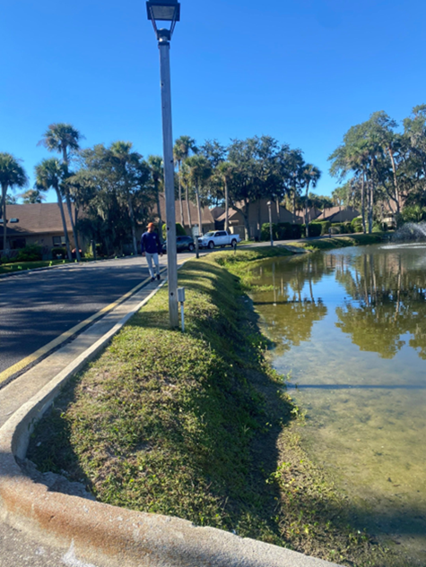
BEFORE
Restoration

Slide 19
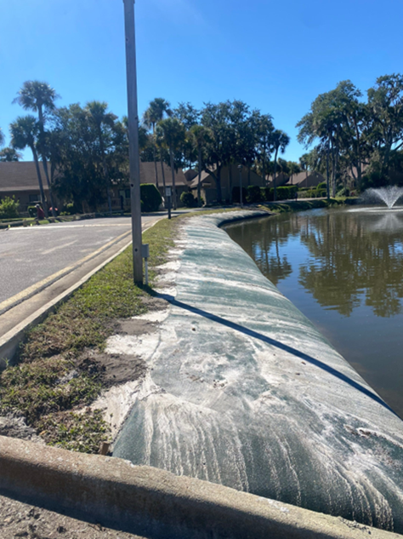
DURING
Restoration

Slide 20
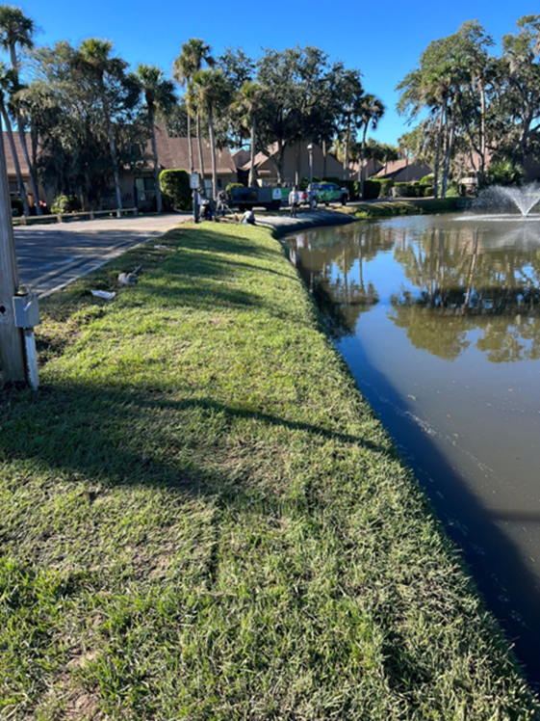
AFTER
Restoration

Slide 21
Bid overview

Slide 22
Shoreline Restoration BIDS
COMPANY | SYSTEM | NOTES | COST
Allstate Resource Mgmt | Geo-Tube | 10 year warranty | $198,900
Aquagenix | TBD | TBD | TBD
Erosion Barrier | TBD | TBD | TBD
Lake Doctors, Inc. | DredgeSOX | 1 year warranty | $251,485
Solitude Lake Management | DredgeSOX | 5 year warranty | $144,900
Notes:
All quotes include similar basics: ~2,200 linear feet of system (@ ~6”) which adds back 3-4 ft overall once you account for the slope, clearing current shoreline of debris and prepping for install, working around existing irrigation, bringing in fill, pumping it in, grading slope, layering with sand/fill, installing sod, securing system to ground

Slide 23
Recommendation

Slide 24
DredgeSOX system
Use of DredgeSOX system, which offers:
Newer technology
Likely more durable
Non-toxic material (no microplastics)
Mesh allows for deeper root penetration of vegetative cover for additional stability
Solitude has most competitive price for this technology

Slide 25
FINancing

Slide 26
FINANCING OPTIONS
Save/pay out of reserves (how much do we have and can it be put towards this?)
HOA obtains bank loan; homeowners make payments until paid in full
Estimate $100 per quarter for 5 years?
Option to pay in full up front?
Special assessment (two assessments?)
Estimated ~ $1,200 per household

Slide 27
QUESTIONS?
Lake Erosion Committee
Lauren Eldaher
Brandon Kravitz
Jody Lukens
Dave Marty

